Slide 1
Basic transformations
continuation
Basic transformations
continuation

Slide 2
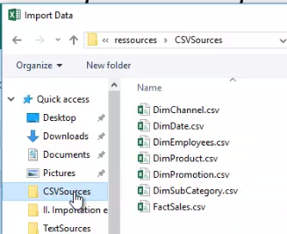
Basic Transformations
Note: This Lab uses the DimEmployees.csv file located in the resources/ CSVSources folder
DimEmployees .csv file location page

Slide 3
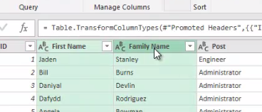
Basic Transformations
Load the file into the editor and notice that the table structure is composed of four columns namely ID , First Name , Family Name and Post
Select both columns First Name , Family Name

Slide 4
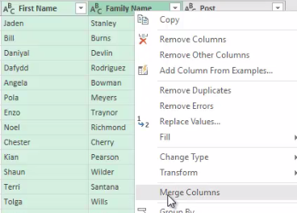
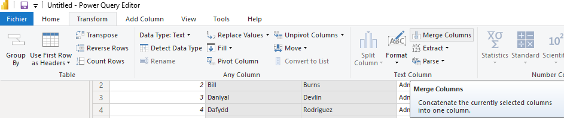
Basic Transformations
Right click mouse and notice the presence of the functionality Merge Columns
Notice the presence of the same functionality in the Transform tab

Slide 5
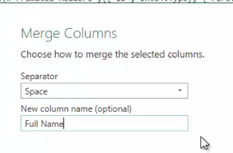
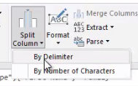
Basic Transformations
Change the separator parameter to Space and the column name to Full Name click OK
Try to go back using the opposite Split Column functionality still in the Transform tab

Slide 6
Thank you
Thank you

